Slide 1
Pharmaceutical chemistry pyrimidine antagonists lect.5
Dr.Leaqaa

Slide 2
Pyrimidine antagonists
Acts through inhibition the synthesis of pyrimidine nucleotide especially deoxythymine monophosphate(dTMP(.

Slide 3
Synth. thymine nucleotide from uracil nucleotide by thymidylate synthetase

Slide 4
Kapecitabin
Xelodar®,
Additional mechanisms: Incorp. DNA / RNA
5-FU metabolism
Tegafur
UFT®

Slide 5
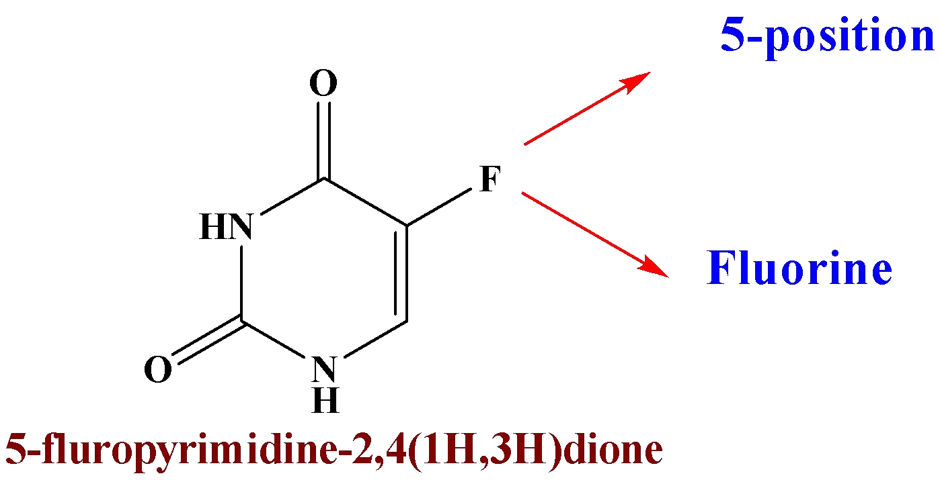
Pyrimidine antagonists products )uracil
Derivative)
Fluorouracil (5-FU(

Slide 6
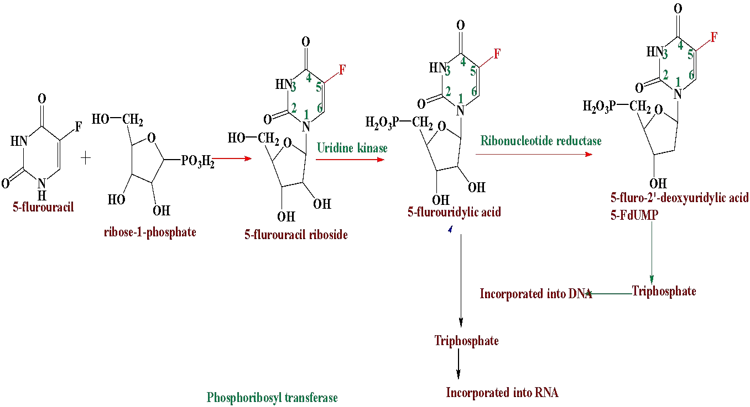
Anabolism of 5-FU

Slide 7
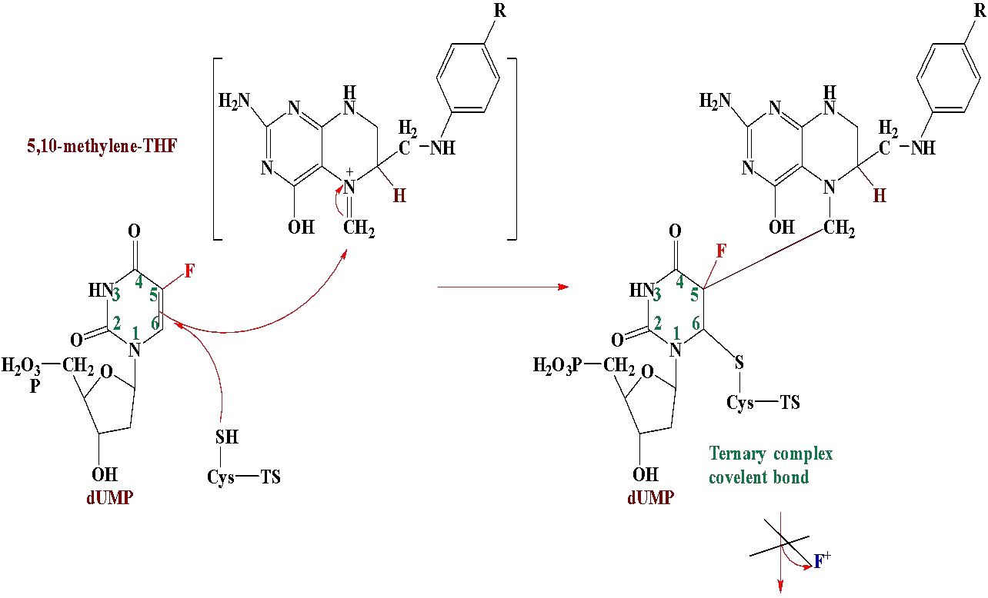

Slide 8
No oxidative breakdown of ternary complex, due the inability of the cofactor to abstract F from its position and this result in:-
No dTMP formation.
No release of DHF (irreversible inhibitor). No regeneration of thymidylate synthetase. No DNA formation.

Slide 9
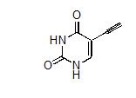
Catabolic inactivation of 5-FU.

Slide 10
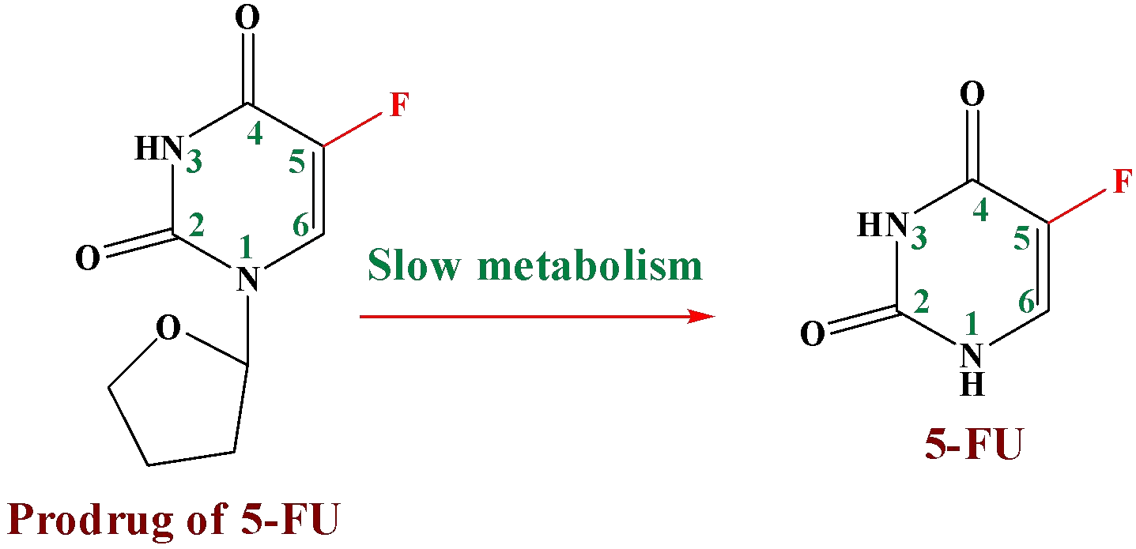
Tegafur

Slide 11
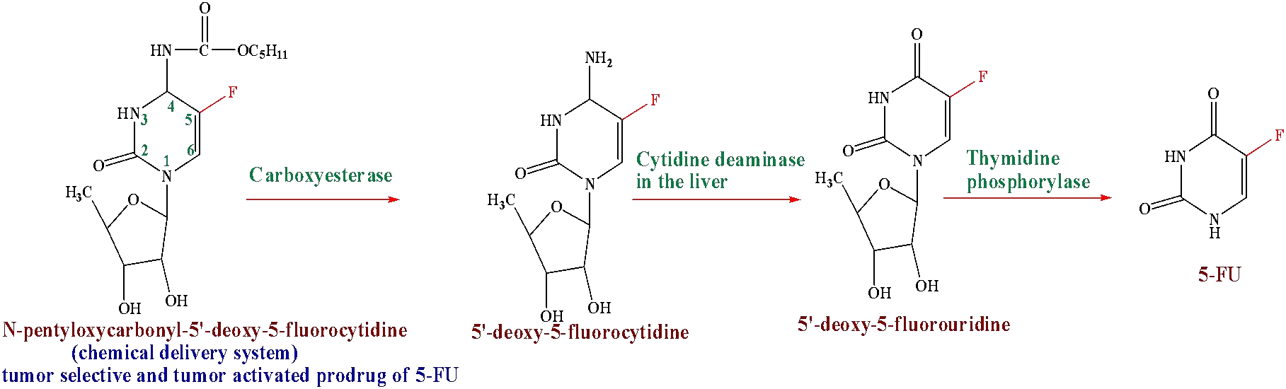
Capecitabine
Used for treatment breast and colorectal cancer

Slide 12
Cytarabine (ARA-C)
Cytarabin®, Cytosar®,
Gemcitasbin
Gemzar®,

Slide 14
Folic Acid analogs as antimetabolites
Metotreksat
Metoject®
Raltitrexed
Tomudex®

Slide 15






Mechanism of action of folic acid antagonist

Slide 16




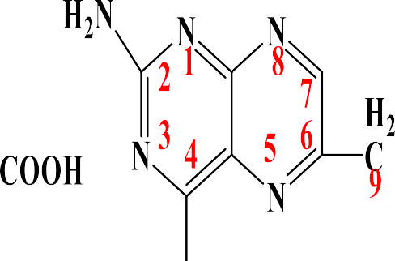









Methotrexate(amethopterin(

Slide 17
The mechanism of action of methotrexate Methotrexate binds tightly to dihydrofolate reductase, blocking the reduction of dihydrofolate to tetrahydrofolate. It is specific for the S phase of the cell cycle.
Resistance to methotrexate can occur because of:-
Decreased carrier-mediated transport of drug into cells. Increased expression of the target enzyme DHFR, due to amplification of the DHFR gene.
Impaired of polyglutamation.
Methotrexate undergoes polyglutamation intracellularly forming a pool of compounds that is retained for months.

Slide 18

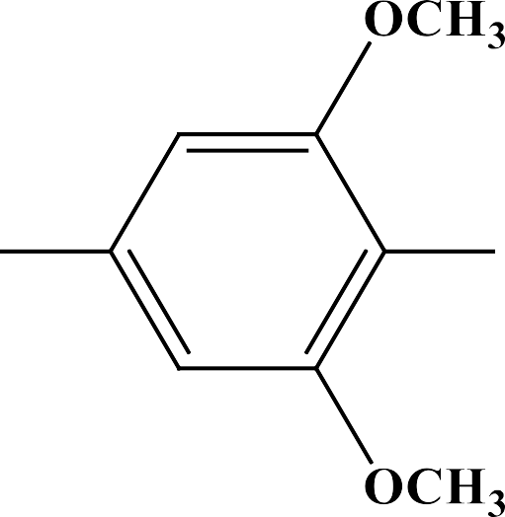












Trimetrexate (use by IV inj only)•

Slide 19
The drug is used to treat colorectal cancer, head and neck cancer as well as nonsmall cell lung cancer (NSCLC).
The mechanism of action of trimetrexate involves folate antagonism and inhibition of thymidylate synthesis.
Trimetrexate does not form intracellular polyglutamate adducts as does methotrexate and other related compounds. Resistance can occur by increased expression of the target enzyme, decreased binding affinity for the target enzyme, or decreased intracellular drug transport.
The major catabolic pathways involve O-demethylation followed by glucuronide conjugation.

